Slide 1

Amazon Sales Data Analysis

Slide 2
Introduction
In this project ,I analyzed the Amazon Sales dataset. Within this dataset lie key attributes such as Country, Region, Item Type, Unit Sold , Unit Price, Total Revenue , Total Profit etc. For analysis I used Python.
Firstly I applied Exploratory Data Analysis i.e. check the missing values , summary statistics of numerical variable by describe
and find the number of item in each categorical attributes. Then check correlation between every two attributes.
Then I applied Segmentation Analysis i.e. check the relation between categorical and numerical variable and find the pattern by using different types of charts . In final step I did Time Series Analysis , here I analyzed the pattern of Total Revenue , Total Units sold with respect to every year, month and overall .

Slide 3
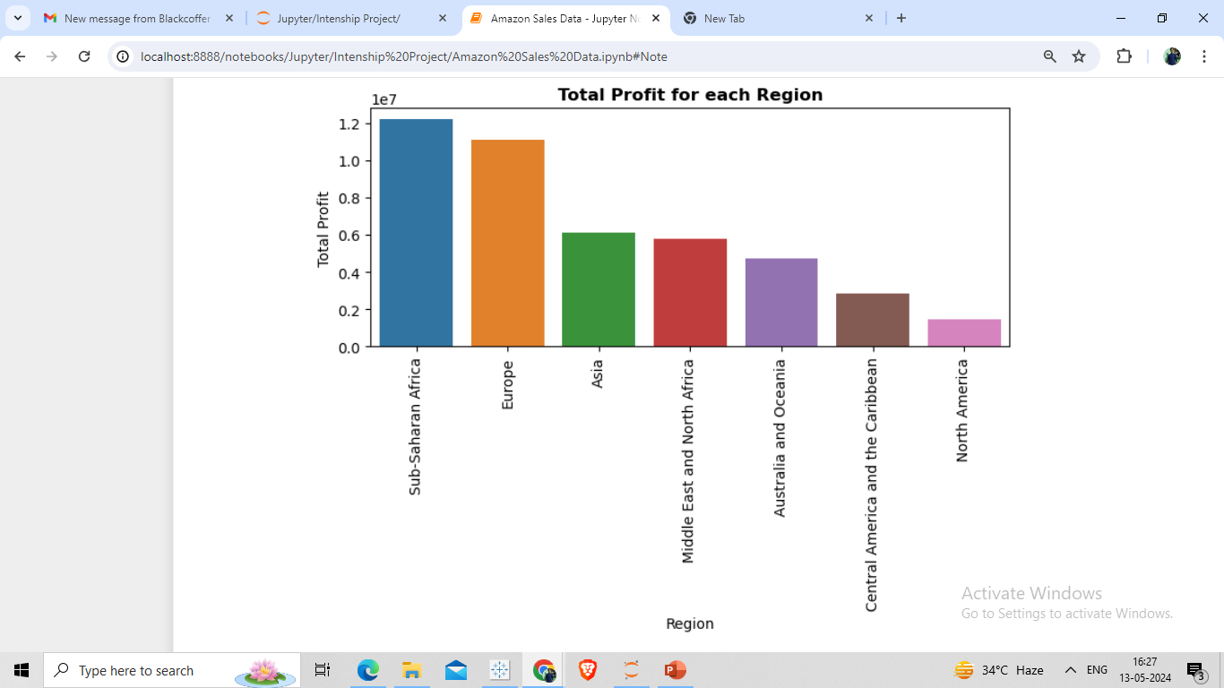
Maximum Profit got from Sub-Saharan Africa Region and lowest from North America.

Slide 4
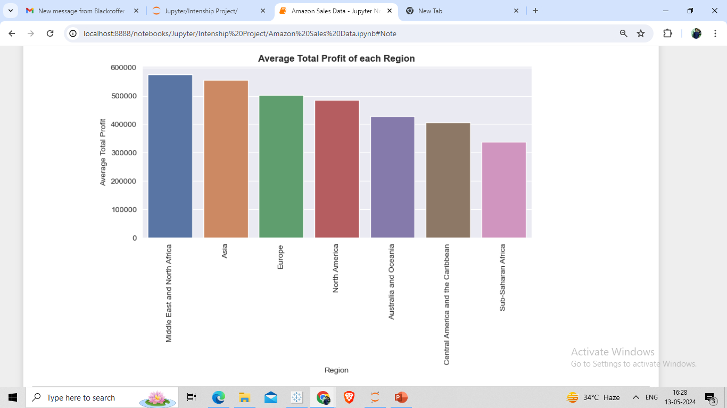
In Middle East and North Africa maximum Average Total profit but in Sub-Saharan Africa minimum Average Total Profit.

Slide 5
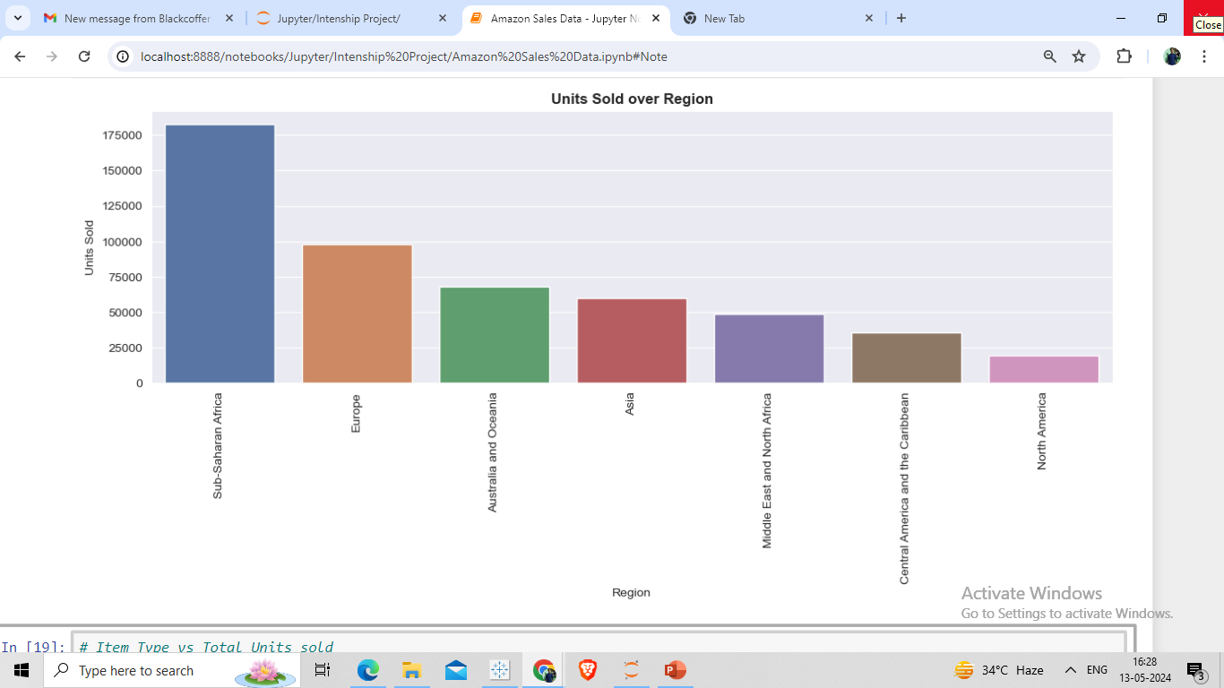
Maximum Units sold in Sub-Saharan Africa and minimum in North Africa.

Slide 6
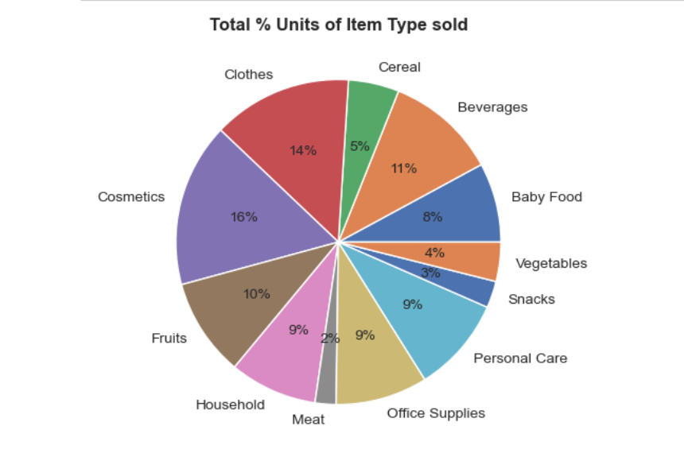
Cosmetics and Clothes item Type units sold mostly.

Slide 7
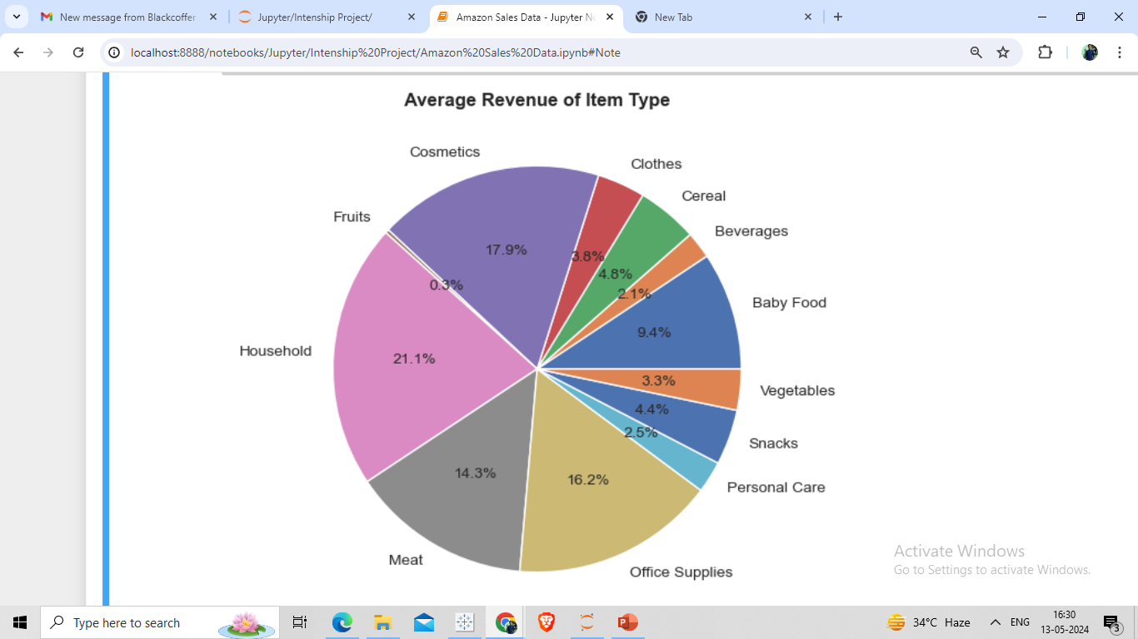
Approximate 80% of revenue got from some of Item Type i.e. Cosmetics , Household , Meat , Baby Food and Office Supplies.

Slide 8
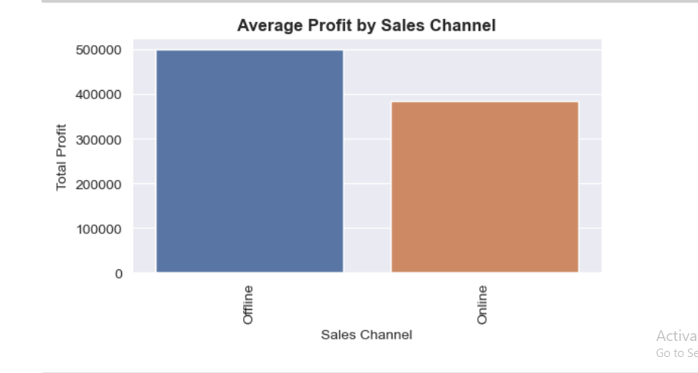
The offline shopping is more profitable with respect to the online shopping . In offline , the average profit is much better than the online average profit .

Slide 9
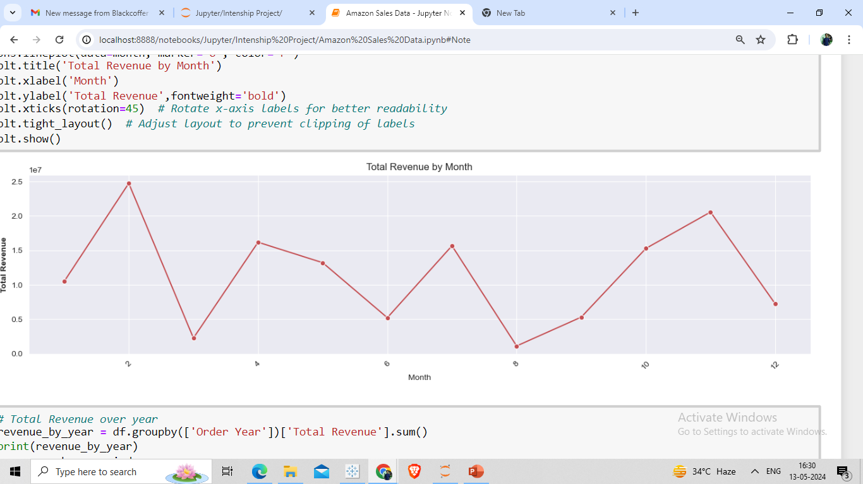
Total Revenue in every month.

Slide 10
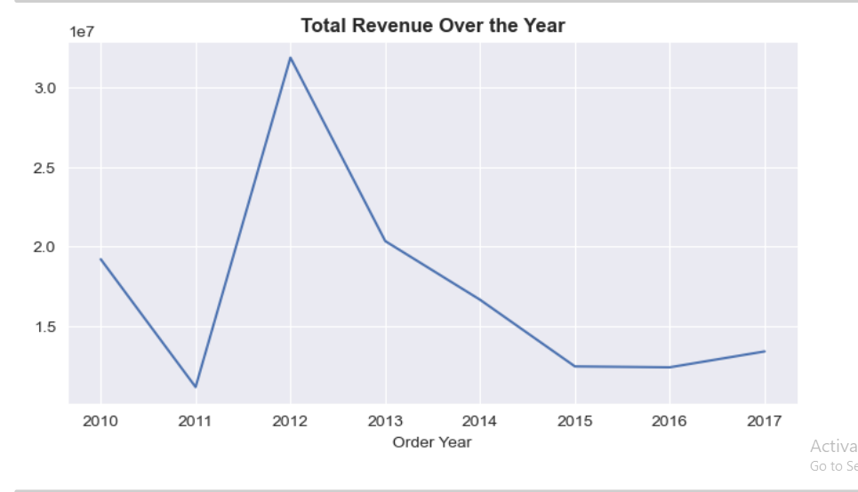
Total Revenue Over the Year. Maximum revenue got in 2012 but after that ,the revenue kept decreasing.

Slide 11
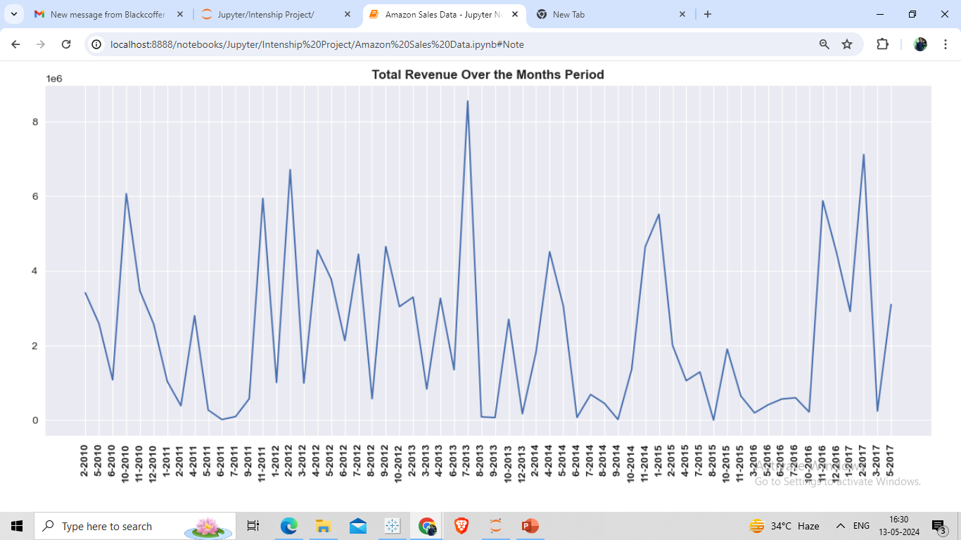
Total Revenue over the every month. Maximum Total Revenue got in July 2013

Slide 12
Thank you

